Slide 1
Internet of Things: Connections, Data exchange and security
Michalis Panayides
Registration number: 1701922
Supervisor: Dr Hossein Anisi
Second Assessor: Mr Joseph Walton-Rivers
BSc Computing and Electronics

Slide 2
Overview of the project
My individual capstone project for CE301 is about Internet of Things and more specifically about the connections, data exchange and security. The main purpose of the project is to create connection between two devices, sent data to that connection and also make this connection safe so it can be used for Internet of Things industry. MQTT protocol is implemented. The aim is to let the user understand how some mechanisms of IoT working. Project has as objective to simulate a real IoT system. Project is divided into two parts, first part is about connections without MQTT and second with MQTT.

Slide 3
What is Internet of Things
Internet of Things is a new technology which is aiming to make ‘things’ become ‘smart’. IoT is a mixture of hardware and software, used to do something useful for the user. Through small powered devices like sensors or using some piece of code data is gained. Then this data is send and received, where is edited in order to do something with the data collected. Internet of Things, have several connections in order to receive and send data. Nowadays IoT is developing rapidly, having millions of applications happening. Internet of Things systems are making life easier, since some things seemed difficult in past are becoming easier. There are also some issues in this technology, like lack of security and privacy. This project is suggesting ways where these problems can be solved.

Slide 4
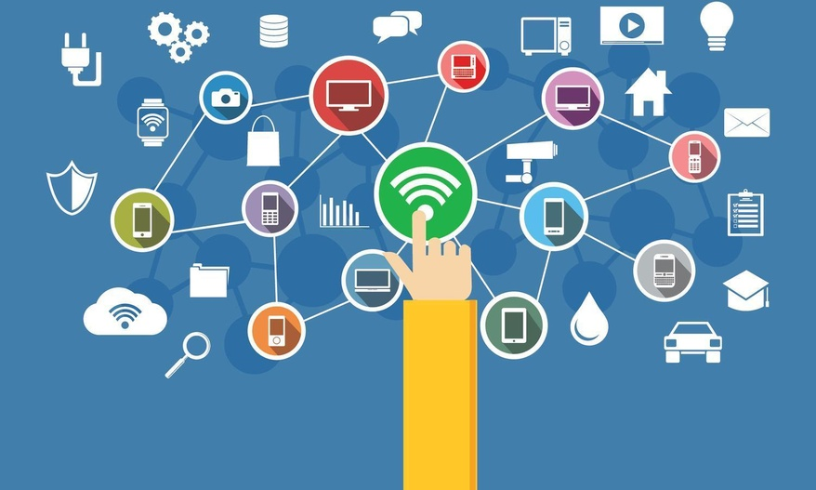
How was built
Two Raspberry Pi 3 Model B+ are used to make the project more suitable for IoT.
Server/Client model is adopted.
Coding done in Python.
MQTT implemented
Mosquitto broker implemented in 4th feature

Slide 5
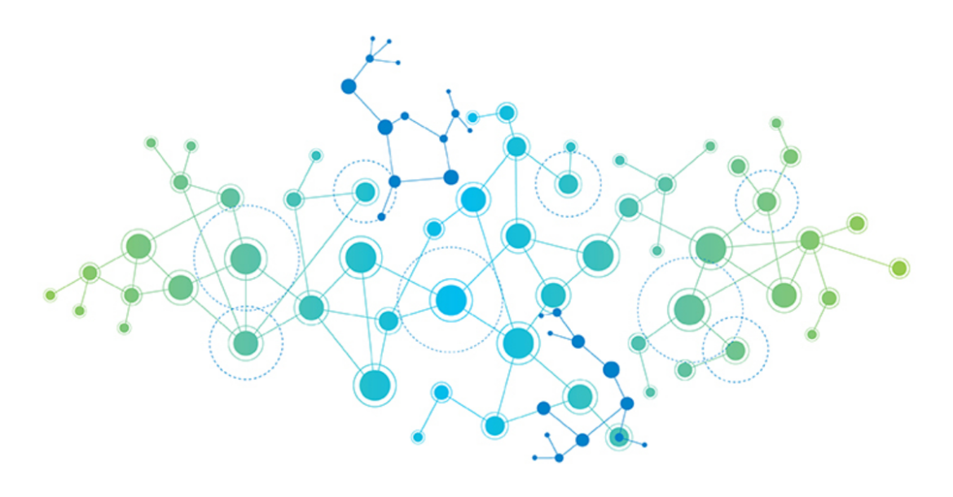
Features of the project
Make connection with client
Start conversation with client
Allow conversation between clients one at each time
MQTT implementation & broker configuration

Slide 6
How it works
Everything is executed from terminal window of Raspberry Pi
Firstly a python code is run from server’s Pi, at this stage a connection is created, waiting for someone to connect
Secondly a python code is run from client’s Pi, at this point connection with server is made, and the command conversation is started
This procedure is followed and later on in subscriber/publisher mode
In the final part, where an MQTT broker have to be set up, some configuration instructions must be followed by user, to create password and username authentication

Slide 7
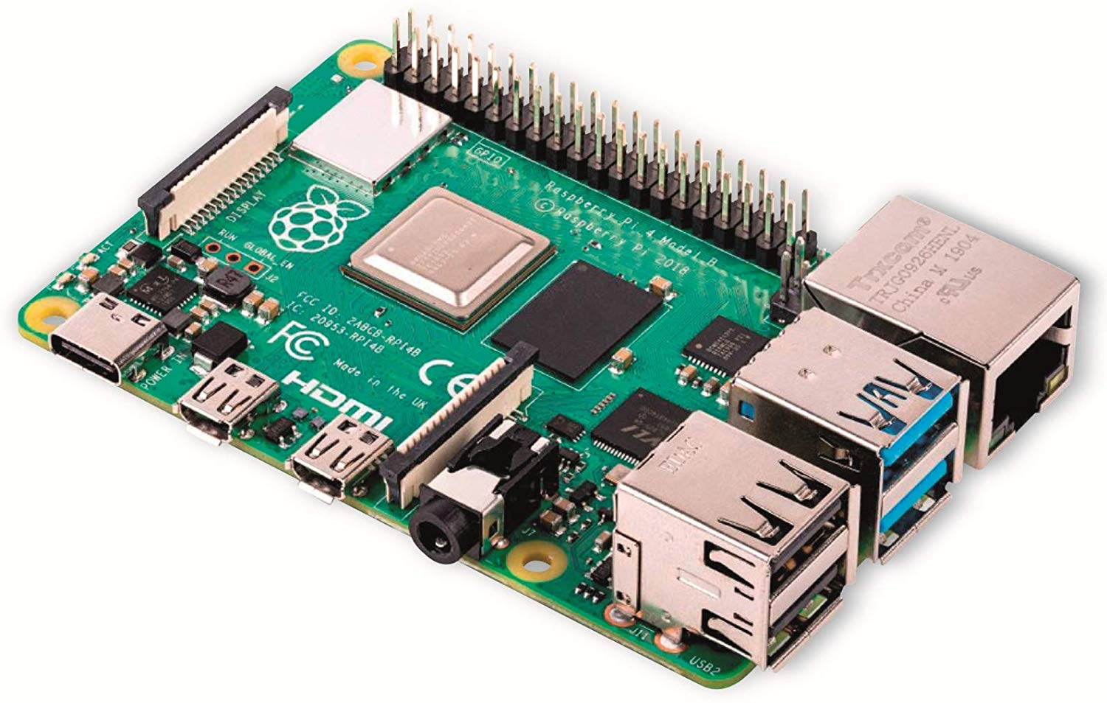

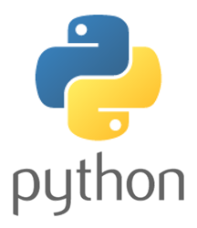
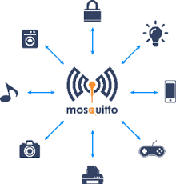
Technology choices
Because of the Internet of Things technologies there were some important decisions that have been taken in both software and hardware, in order for the project to be more IoT friendly. Below are tools used in the project:
MQTT
Mosquitto
Raspberry Pi
Python
Jira

Slide 8
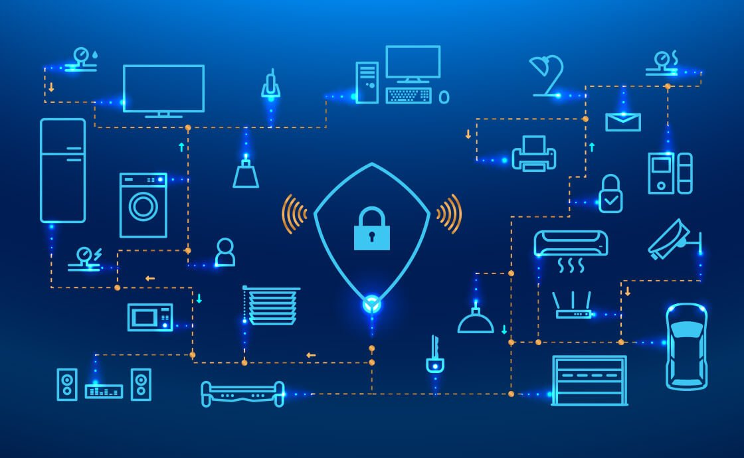
Project Goals
Make the user learn about Internet of Things
Secure the connections happening by MQTT authentication
Find ways to improve security
Help someone understand how MQTT works
Filter messages
Set up a Mosquitto broker

Slide 9
Implementation
Project divided in four main parts, one for each feature
In some parts, there were some sub-parts
Implementation started from first feature
Communication and conversation between the two devices before MQTT implementation:
Server is creating a connection
Client connects and start conversation
Four main commands→ HELLO, BYE, CLOSE, BYE
More clients can connect, but only one can have a conversation with the server, there is a standby mode

Slide 10
About the fourth feature:
Again there two different codes have to be run from terminal
Subscriber, subscribes to a topic
Publisher, publishes the message to that issue
Subscriber is filtering the message
Publisher continues to publish, and subscriber continues to receive messages which then are filtering, giving details if the messages published in the correct topic
About the second part of fourth feature the user have to follow some instruction to configure a broker and add authentication to it. Some python libraries and Mosquitto packages have to be installed.

Slide 11
Evaluation, testing and results
Evaluation is one of the most important parts of any project, since it’s the part that the testing is taking place and see if the requirements or features of the product are met. Many tests were done, to evaluate the project and few people asked to give their idea on the project. The results taken were satisfactory.
In each feature, the necessary testing was done, to see that the implementations were correct and the feature is doing what it should.
Through testing some problems, were found.
Most of those problems were solved

Slide 12

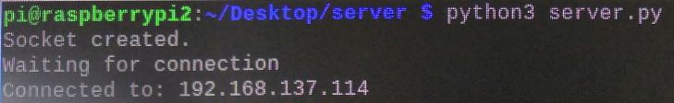
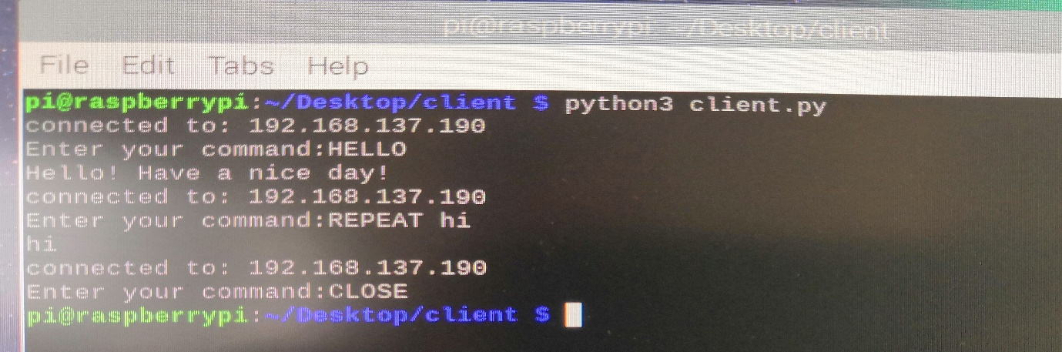
Testing for first and second feature
Testing was focused on the connection and the conversation.
Server waits for connection
Client is connecting and starting conversation.
The necessary messages are printed.

Slide 13
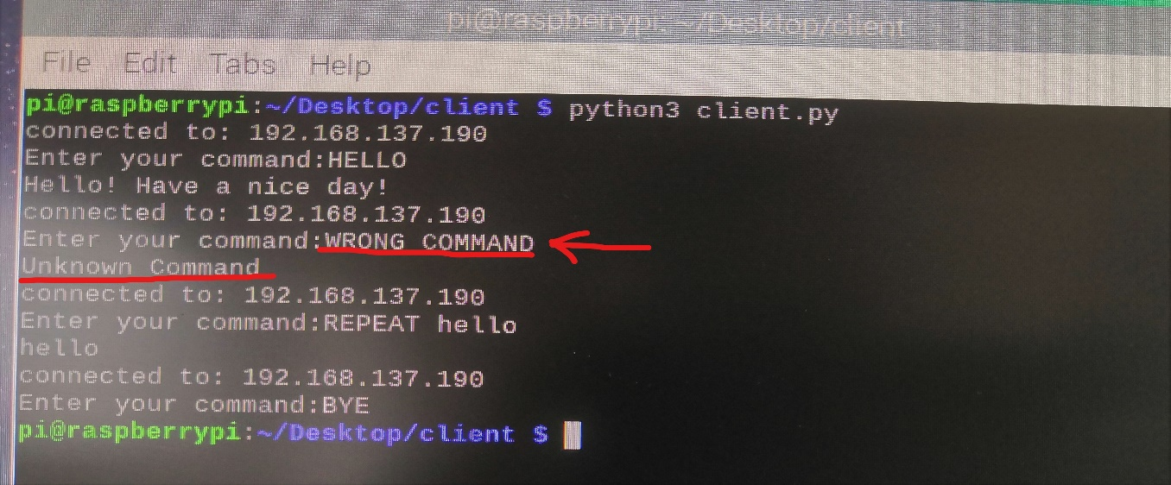
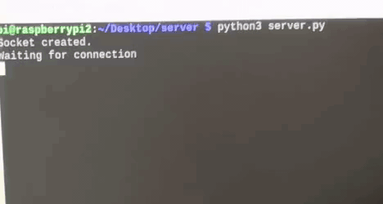
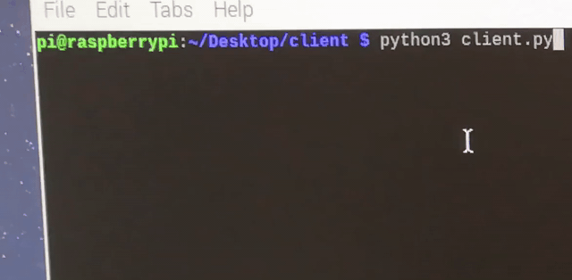
Another test done was done to check if the client can re-enter a command after entering it wrong the first time.

Slide 14
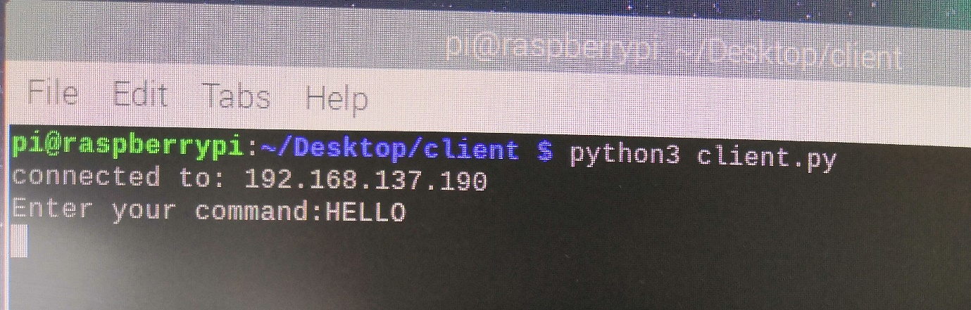
Testing the third feature-connection with more clients can be made but conversation can’t be created until the server is freed.
The second client, gets into a standby mode, where he can send the first command, but it will not receive a reply, until the other client left the conversation

Slide 15
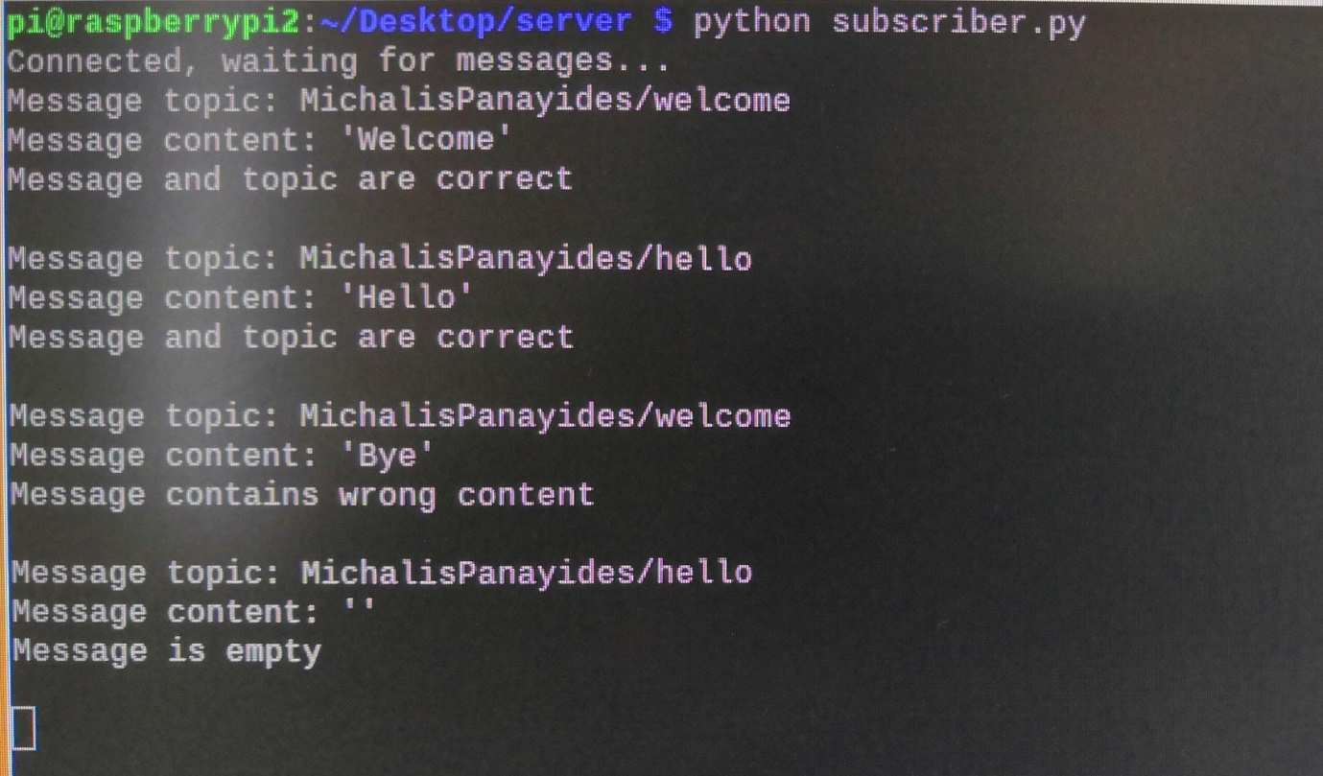
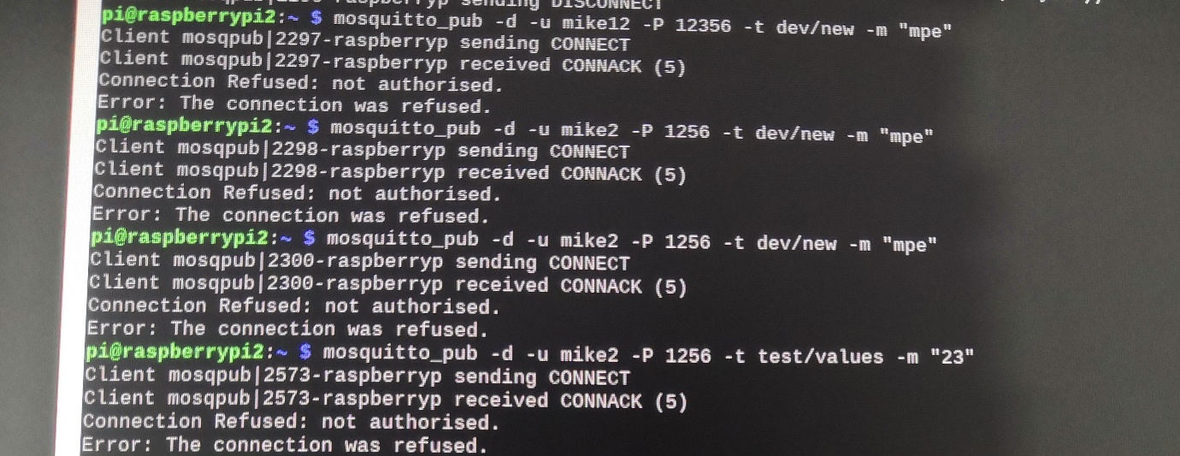
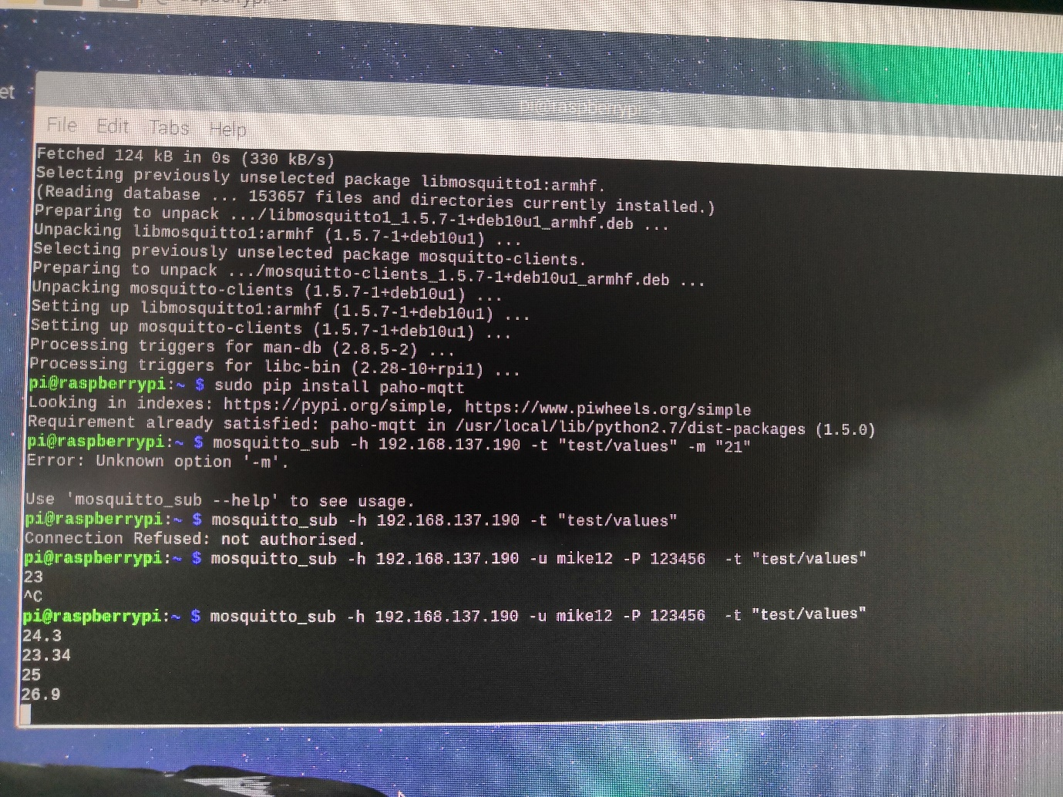
Testing the fourth feature
To codes for publisher and subscriber were checked, working as expected in first part.
In second part configuration was followed and testing was done in the authentication, which was successful.

Slide 16
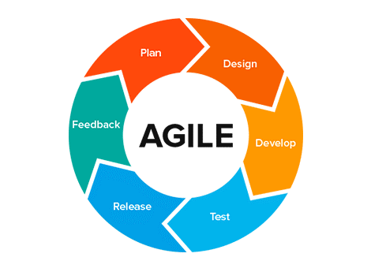
Agile methodology
Agile methodology was followed.
Kanban board was used as part of Agile
Cumulative Flow Diagram and Control flow were created through Kanban board.

Slide 17
Project plan and management
Project was divided into small parts
Each task had a deadline to be completed
A featured had to be completed, before start working on the next feature
Work could be done simultaneous in different parts of the feature
Research was done in parallel
A timetable was followed, to have time management

Slide 18
Problems faced and remarks
In first feature there was a technical issue, connection couldn’t happen because of some router configuration set up by the ISP provider, the solution to this was to use a Wi-Fi hotspot created from a laptop.
In both first and second feature the two codes have to be executed using python 3→ ‘python3 server.py’
In the third feature, only one client can communicate with the other but many can be connected.
In fourth feature SSL was to be implemented, although this wasn’t possible, since in order to create an SSL certificate you have to have a domain name, which means that the data should be uploaded somewhere. The purpose of the project was to simulate an IoT system, if the user had to upload data to a server online this would change the architecture of the project, and make it difficult for the user.

Slide 19
Future work
Some parts can be improved.
There is space for development.
The architecture of the project is flexible which make the project suitable for larger scale IoT systems.
GUI can be added, to make it easier.
More atomization can be added in MQTT part.
System can be used in small smart home applications

Slide 20
Conclusion
Closing, the project is presenting the basic knowledge some can learn for IoT. The implementation of the features was successful and they achieved the expected outcome, but of course there is space for improvements. The user understand how connections and data exchange happening in Internet of Things systems and is aware of the issue of security in those systems. MQTT is explained as so and the broker’s mechanisms, configurations made on broker added more security in fourth feature and let the user understand how to add username and password authentication into a broker.

Slide 21
THANK YOU FOR YOUR TIME

